Slide 1
Predictive Modeling
Prepared by:
Nithin Thomas

Slide 2
Content of Presentation
Key Insights of the Dataset
Regression Model
Key Metrics - R2, MAE and RMSE
Suggestions for Improvement of Regression Model

Slide 3
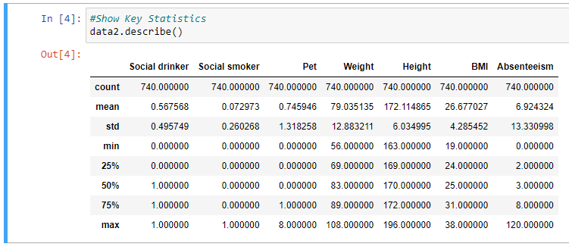
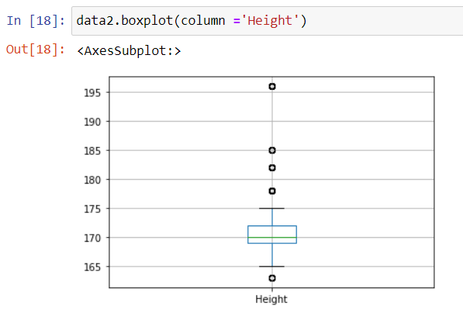
Key Insights of the Dataset
Outliers
Height
Standard deviation is low - More datapoints lies very close to the mean value of the population.
Few data points are only lying very far from the mean value which are possible outliers.
Positive skewed - Mean in larger than the Median for positively skewed distribution.

Slide 4
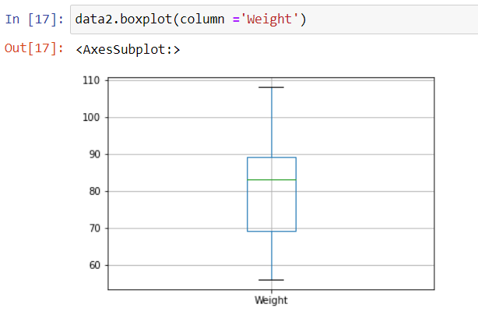
Key Insights of the Dataset
Weight
Datapoints are clustered across the mean of the population.
Standard deviation is high - the data points are clustered around the mean value.
There are no outliers in the dataset.
Negative skewed - Mean in lesser than the Median for negative skewed distribution

Slide 5
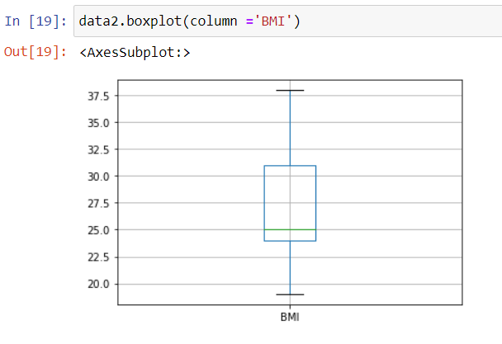
Key Insights of the Dataset
BMI
Standard deviation is low - more datapoints lies very close to the mean value of the population.
There are no outliers in the dataset.
Positive skewed - Mean in larger than the Median for positively skewed distribution.

Slide 6
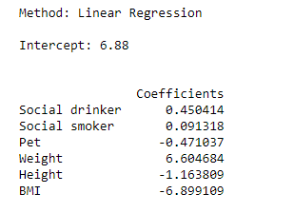
Regression Model
Dependent Variable(Label)
Independent Variable(features)
Absenteeism = (0.45 x Social drinker) + (0.091 x Social smoker) + (-0.471 x Pet) + (-6.605 x Weight) + (-1.164 x Height) + ( -6.899 x BMI) + 6.88
Coefficients
Intercept
Independent variables (‘Social smoker’, ‘Social drinker’ & ‘Weight’) has a positive impact on the dependent variable ‘Absenteeism’ i.e., as these independent variables increases dependent variable tends to increase.
Independent variables (‘Pet’, ‘Height’ and ‘BMI’) has a negative effect on the dependent variable ‘Absenteeism’ i.e., as these independent variables increases dependent variable tends to decrease.
‘Weight’ has the highest positive impact and ‘Social smoker’ has the least impact on the dependent variable among all the considered independent variables.

Slide 7
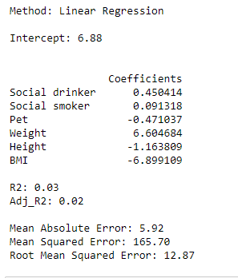
Key Metrics -R2, MAE and RMSE
R Square(R²) = 0.03 or 3%
Not a good fit, regression model is only able to predict 3% of variation caused in Absenteeism by the independent variables.
Mean Absolute Error(MAE)= 5.92
This implies that, on an average the predicated value has 5.92 error from actual value of the dataset in absolute value.
Root Mean Squared Error(RMSE) = 12.87
Higher RMSE implies that there are larger difference in the predicated and the actual values which predicts that the model is not a good fit.

Slide 8
Suggestions for Improvement of Regression Model
Need for more data for building model
Bad assumptions - In actual case, assuming that the data has a linear relationship will not help but instead visualizing the data will help.
Poor features – identify features which have high correlation with the dependent variable.
Adjusted R square increases only when newly added feature improves the model fit so by comparing adjusted R square value we can add or remove independent variables and improve the regression model.
In this case Human Resources Department has to design an employees’ database that includes as much descriptive data as possible about the staff, since the hidden causes of absence could be predicted via these data.

Slide 9


